Slide 1



一站式学习C编程
Yasen – Enterprise Architecture
YouTube: @yasenzhao
C
https://github.com/yasenstar/learn-c/tree/main/OneStopC

Slide 2
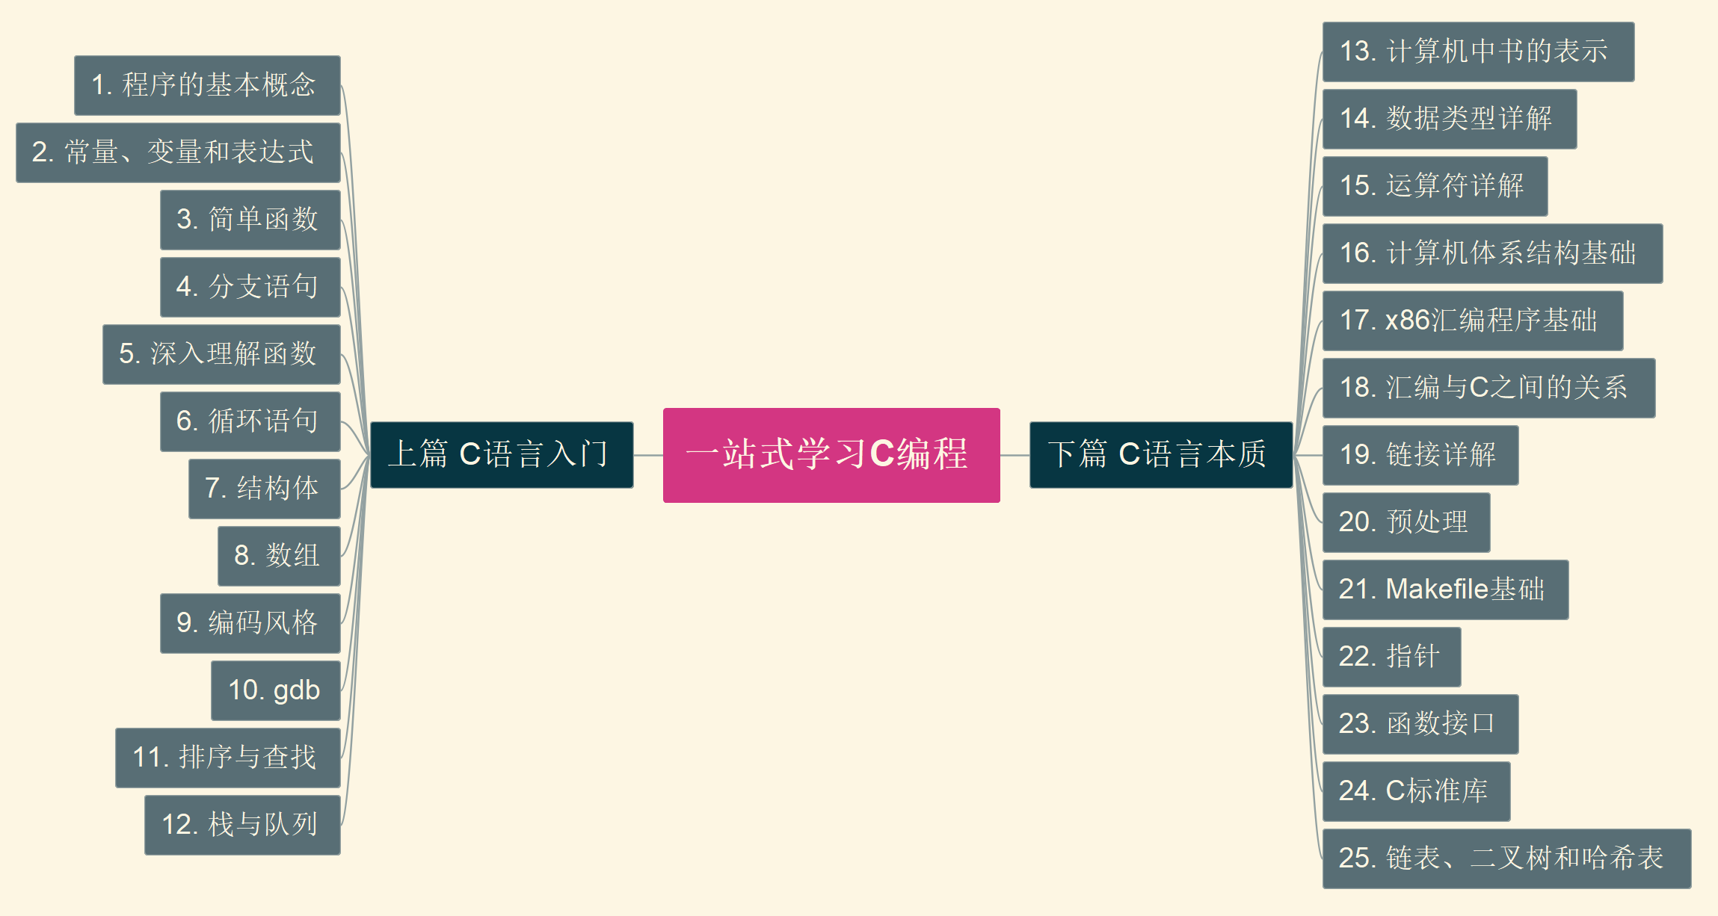
001
一站式学习C编程
开篇与介绍
https://github.com/yasenstar/learn-c/tree/main/OneStopC

